Slide 1
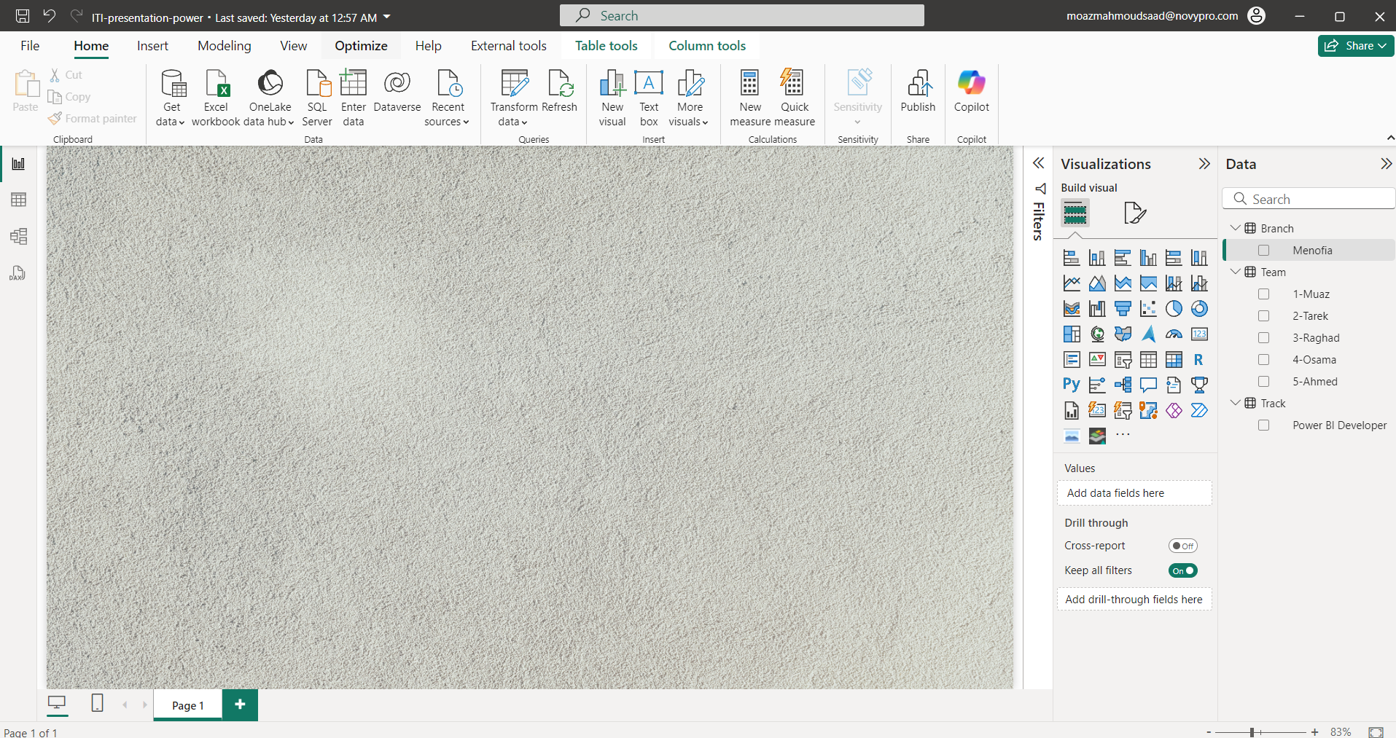

ITI Graduation Project – Presentation ITI Examination System
Intake Q3 - 2024
Team Members
Muaz Mahmoud Saad
Ahmed Tarek Hamed
Raghad Ashraf Elghobashy
Osama Mostafa Ghanem
Ahmed Ashraf Ahmed

Slide 2
Agenda
Intro
Project Overview
Technical Details
Desktop Application
Challenges and Solutions

Slide 3
Project Overview
In this project we try to Build ITI Examination System
Organizing project tasks among team members
Applying Database Design Principles
Building Desktop Application
Presenting the data in SSRS Reports and Power BI dashboards
Perfectly planning and organizing all the details from the ERD – Linked post
The Question is how to organise and plan all that?????????

Slide 4
Project Phases – Trello
Dividing the project into three phases and each phase has a set of tasks and each task goes from
Planned in progress Testing Done
Each task must goes across all those status and it may be revisited again based on the situation

Slide 5
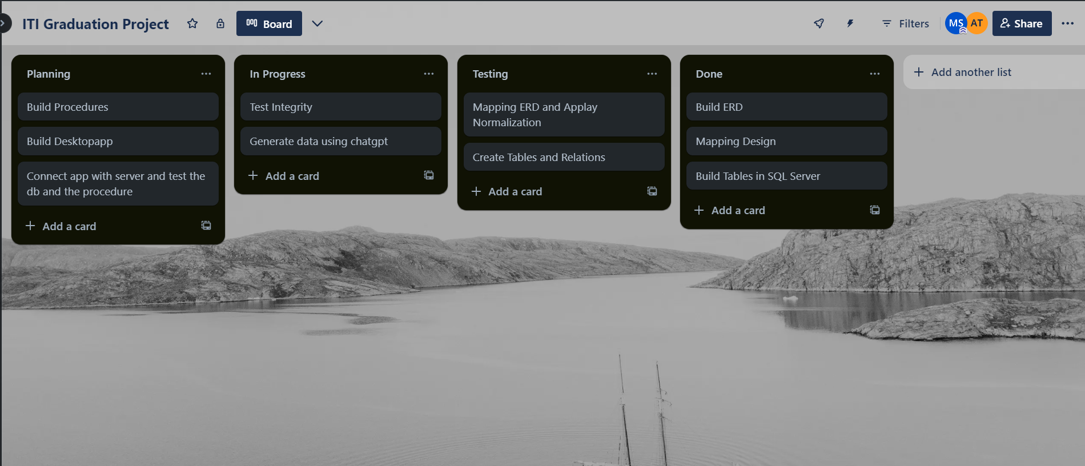
Project Phases – Trello ( Phase-1 )

Slide 6
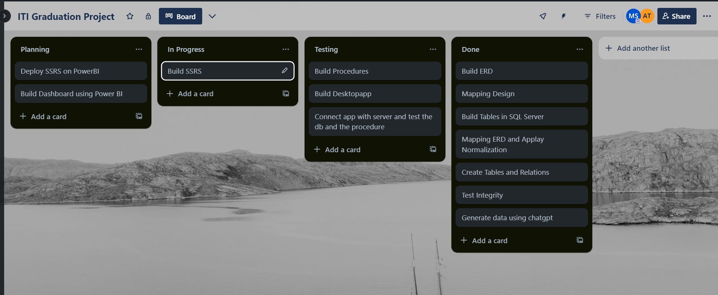
Project Phases – Trello ( Phase-2 )

Slide 7
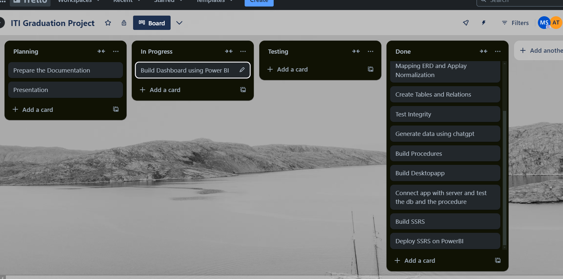
Project Phases – Trello ( Phase-3 )

Slide 8
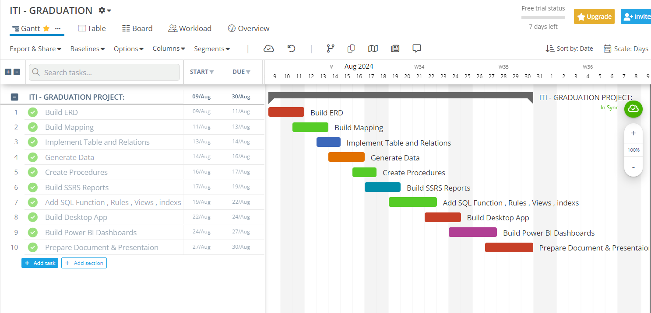
Project Phases – Gantt Chart
So for now what we did from 9/8/204 : 31/8/2024
how we use those 23 days ???

Slide 9
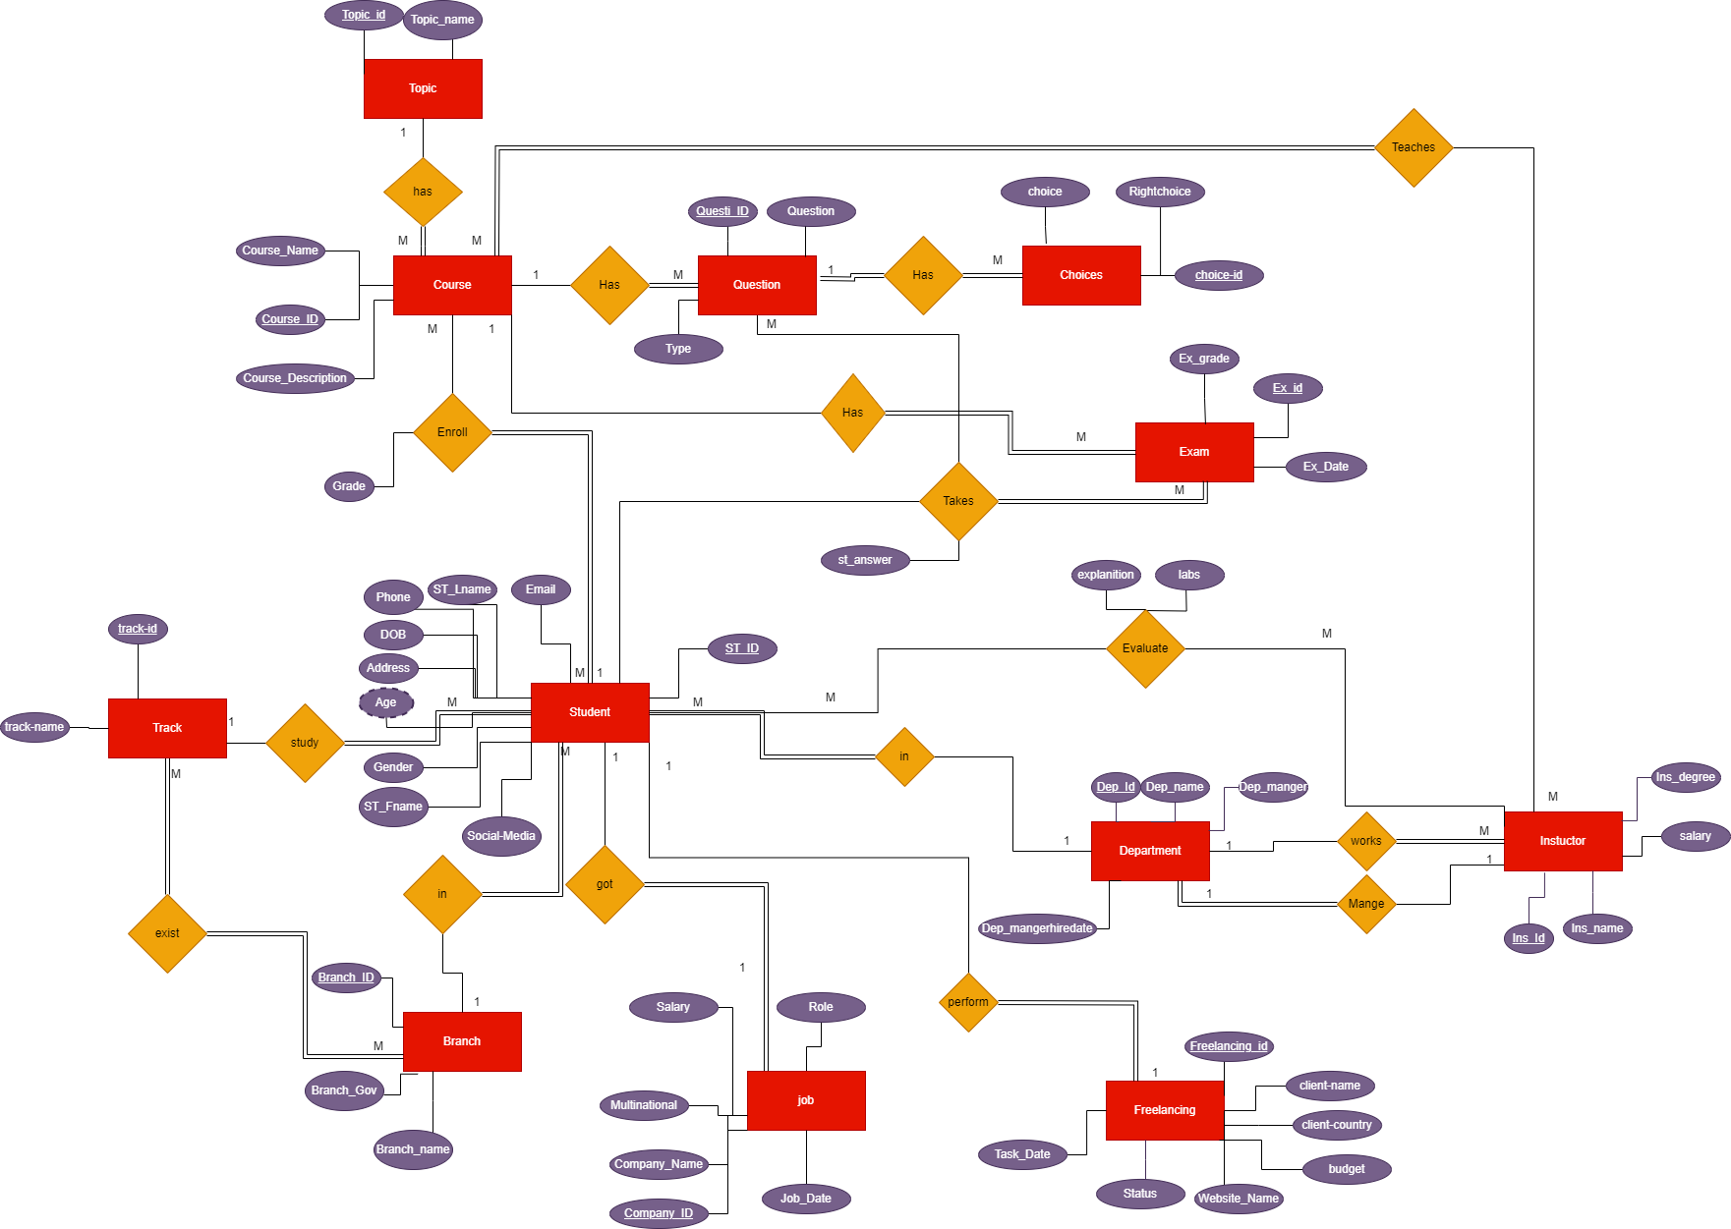
Technical Details - ERD

Slide 10
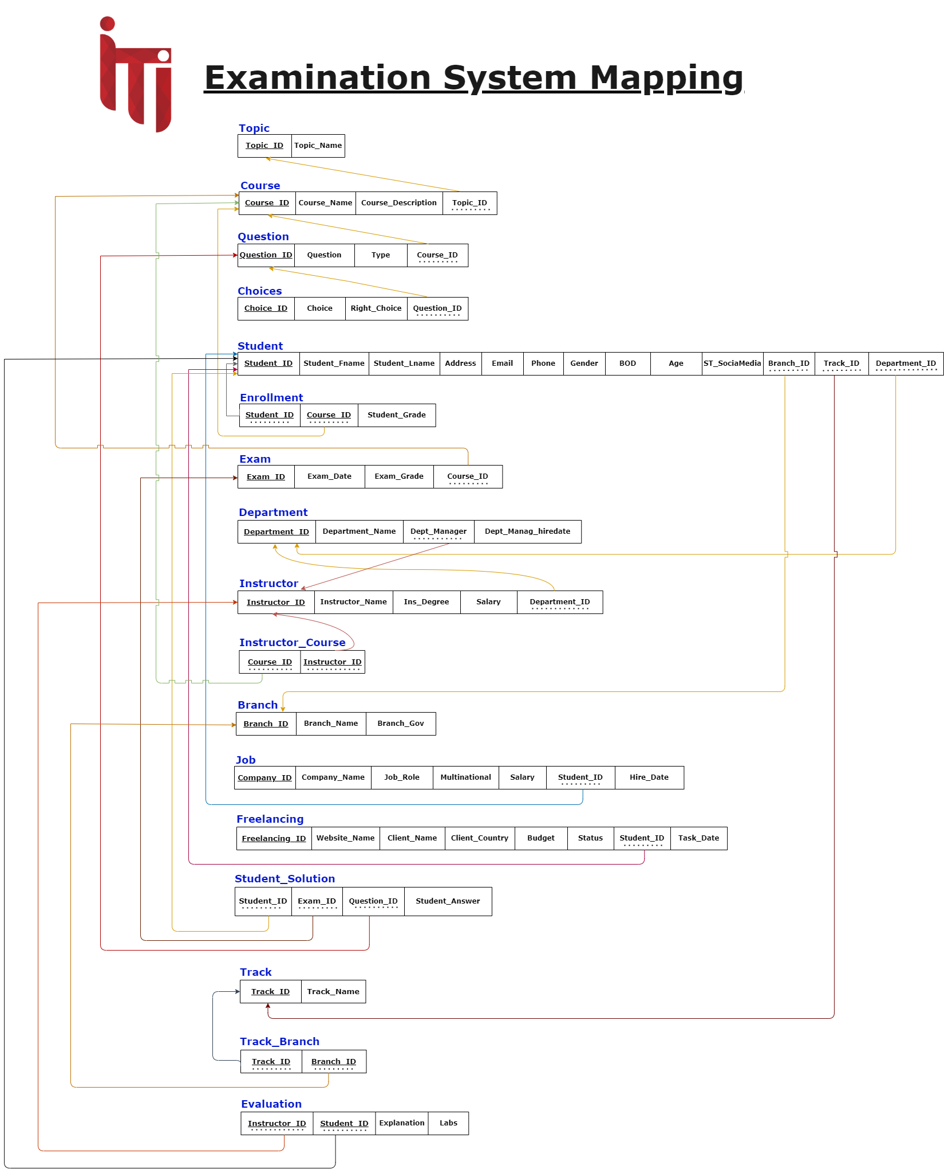
Technical Details - Mapping

Slide 11
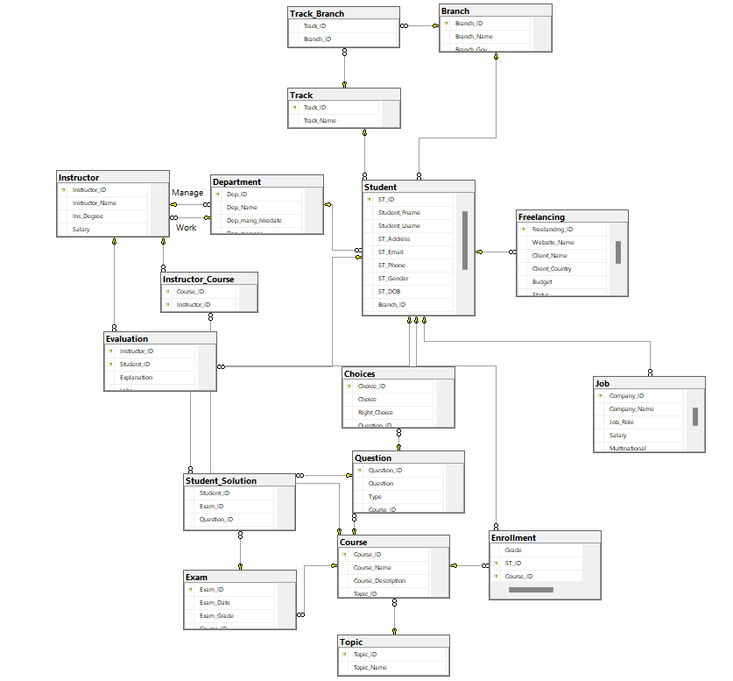
Technical Details - Schema

Slide 12
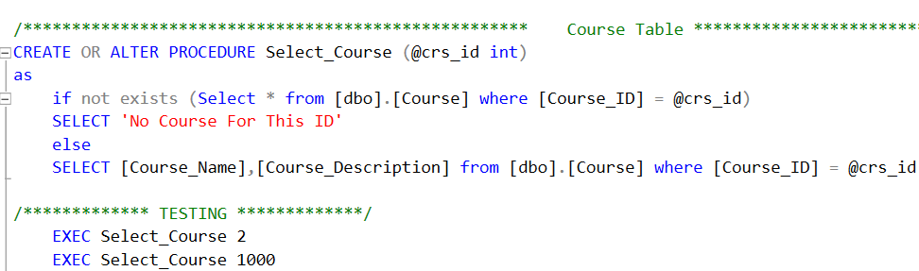
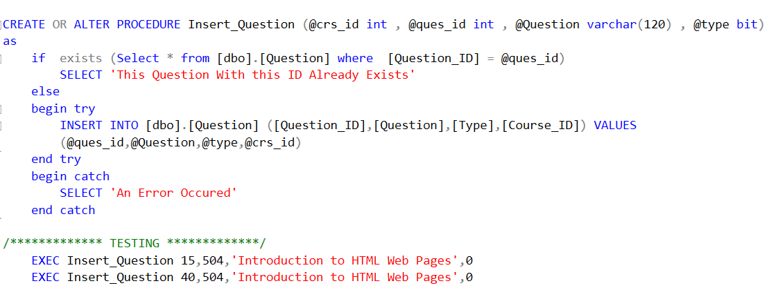
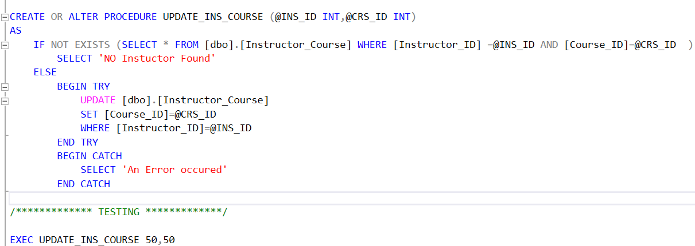
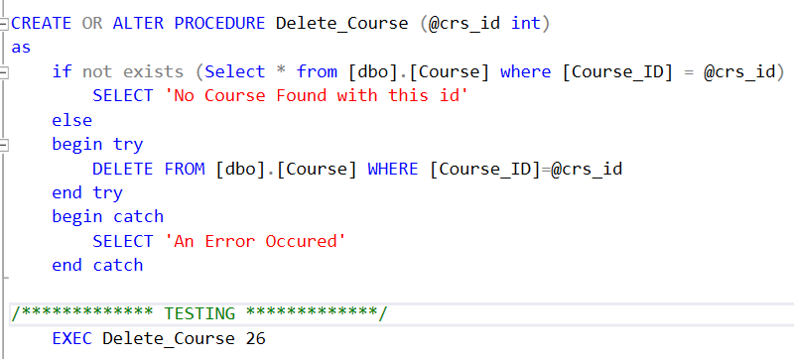
Technical Details – Stored Procedures
For each table we create the 4 procedures (SELECT , INSERT , UPDATE , DELETE).

Slide 13
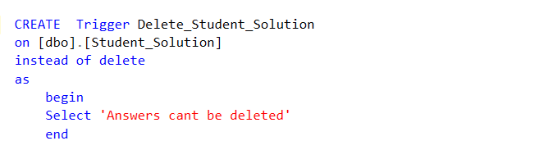
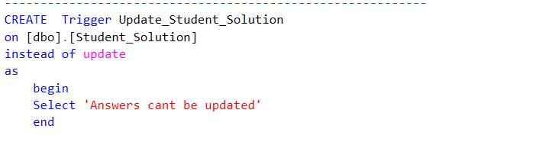
Technical Details – Stored Procedures
Create Two Triggers to prevent deletion or update of the student answers

Slide 14
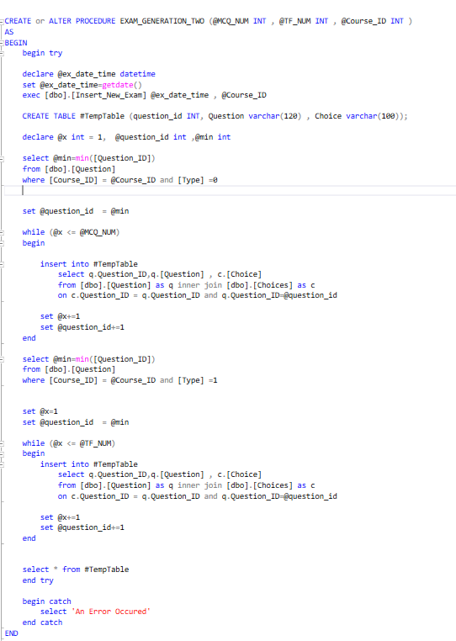
Technical Details – Stored Procedures (Exam-Generation)

Slide 15
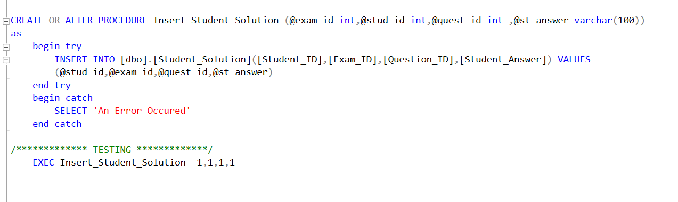
Technical Details – Stored Procedures (insert - answer)

Slide 16
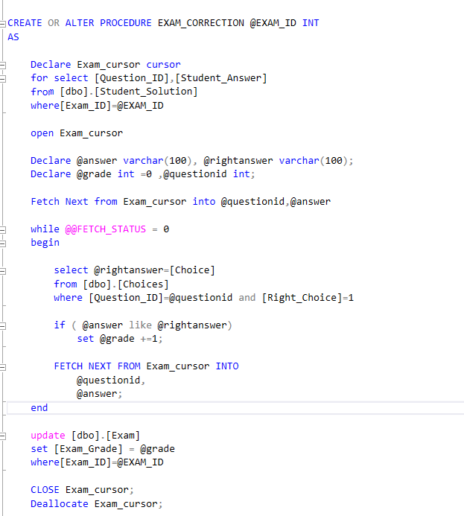
Technical Details – Stored Procedures (Exam-Correction)

Slide 17
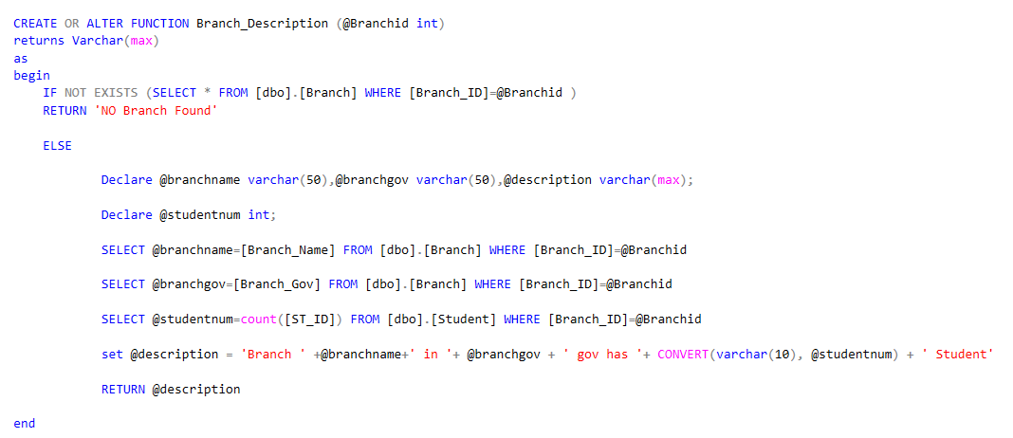
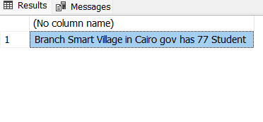
Technical Details – Functions
SQL Scalar function that return a line describe the branch briefly
Notes:
What is function in sql?
Quick brief of the function?

Slide 18
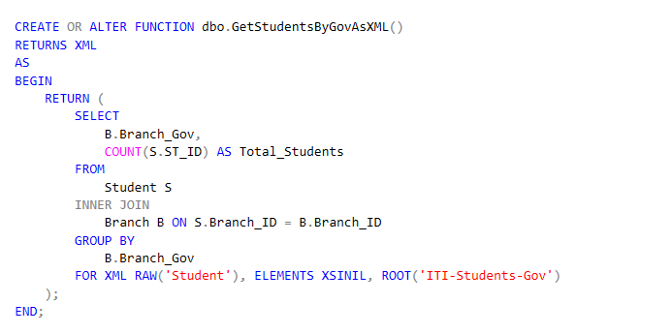
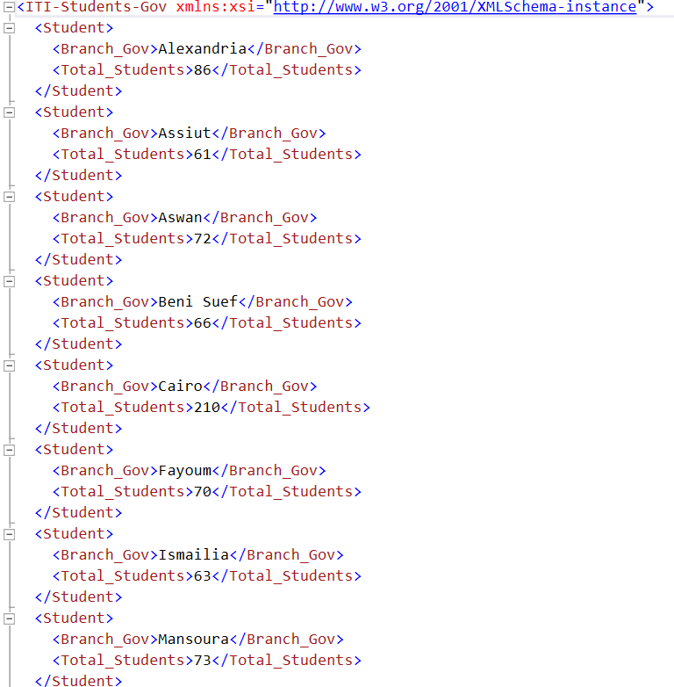
Technical Details – Functions
SQL function that return XML describe the number of student in each branch

Slide 19
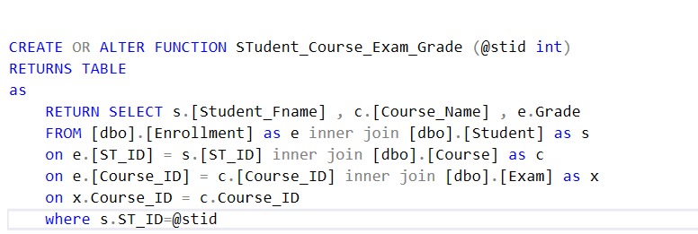
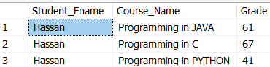
Technical Details – Functions
SQL inline function that return table of student exam course grades

Slide 20
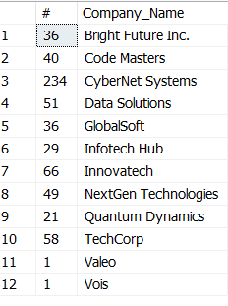
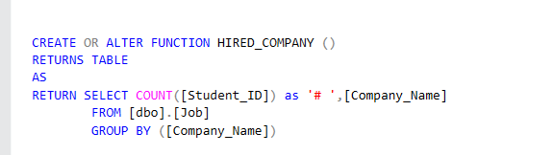
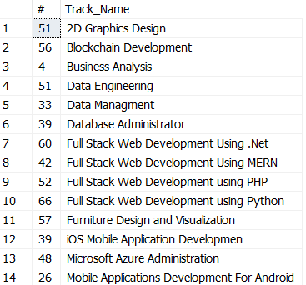
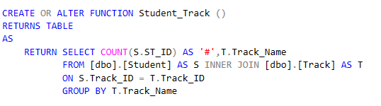
Technical Details – Functions
SQL inline function that return table contains number of hired students grouped by company
SQL inline function that return table contains number of hired students grouped by tracks

Slide 21
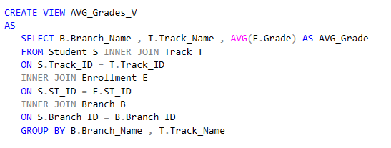
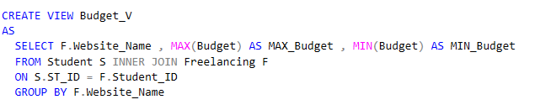
Technical Details – Views
VIEW to display Average grades for students by Branch and Tracks
VIEW to display MAX & MIN $ budget and freelancing platform for freelancing jobs

Slide 22
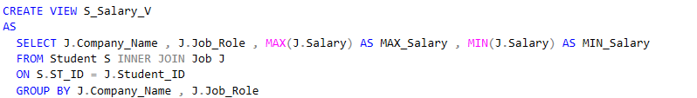
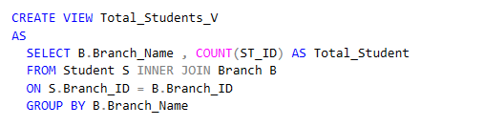
Technical Details – Views
VIEW to display MAX & MIN $ Salary and Company Name for Student who got jobs
VIEW to display # of Students for every branchy

Slide 23
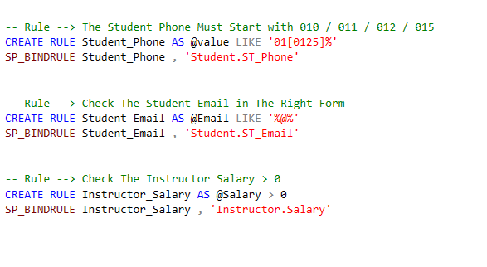
Technical Details – Rules
We build three rules to insure the data validation
Rule to check the phone is right
Rule to check the mail validation
Rule to check the salary > 0

Slide 24
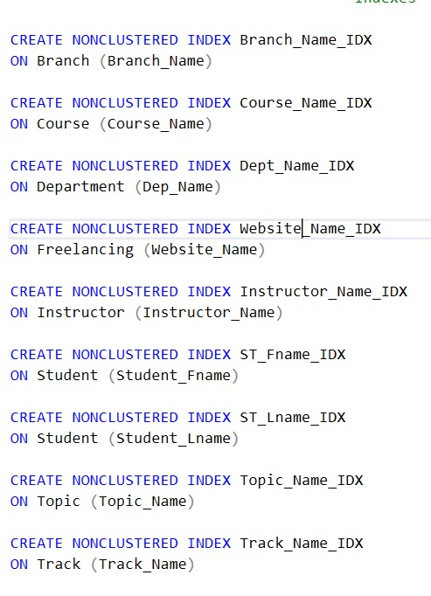
Create the possible index on the tables to make the process of retrieving data faster.
Technical Details – Index

Slide 25
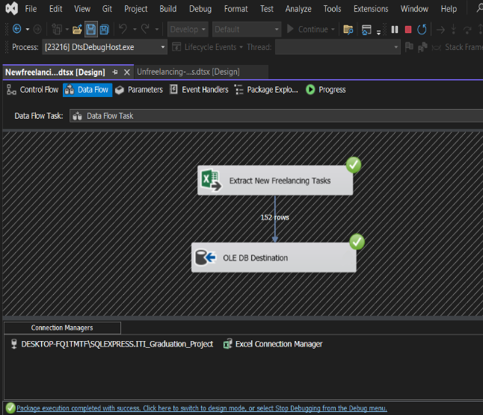
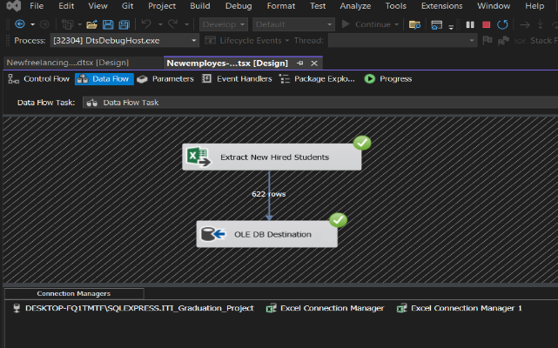
Technical Details – SSIS
We have build 4 SSIS packages ,
the business logic is to follow up with the students that didn’t find a job or didn’t perform freelancing tasks
Also to update the database with the new hired and the students that have done a freelancing tasks

Slide 26
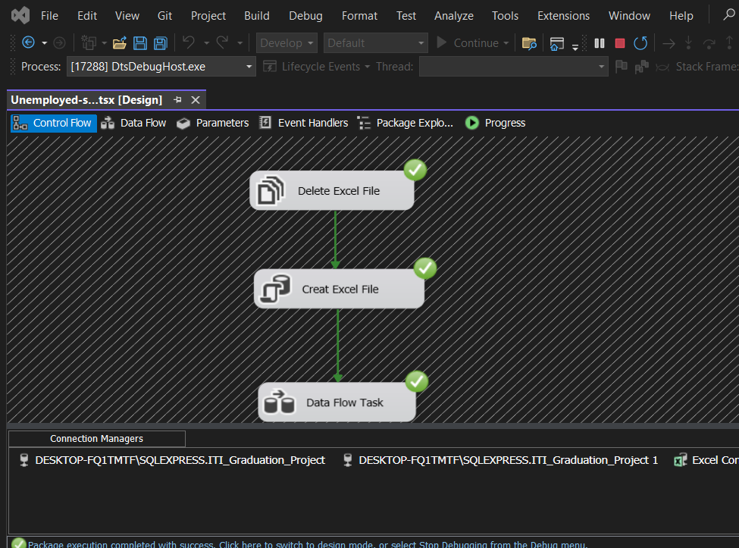
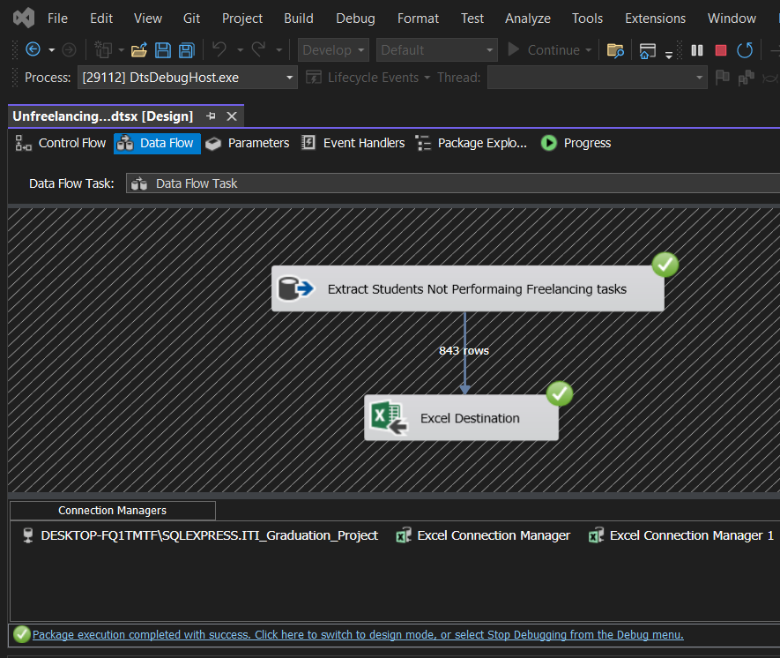
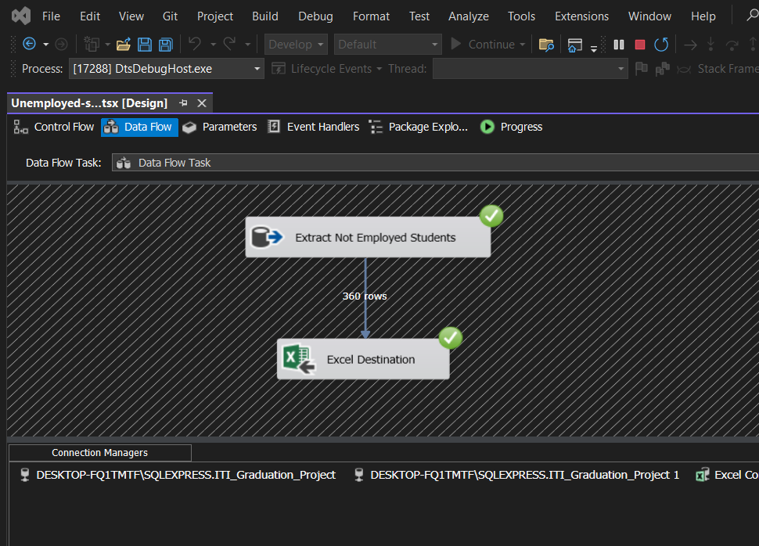
Technical Details – SSIS

Slide 27
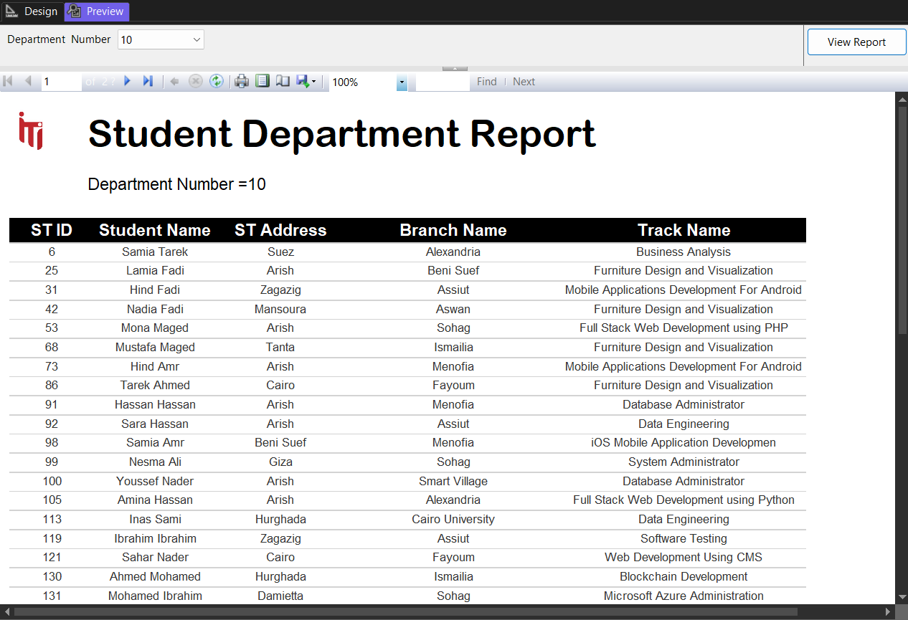
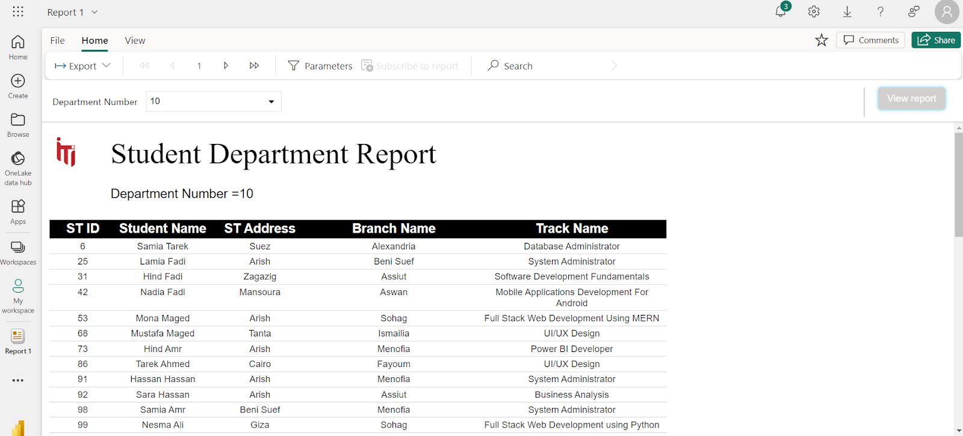
Technical Details – SSRS
Report that returns the students information according to Department No parameter

Slide 28
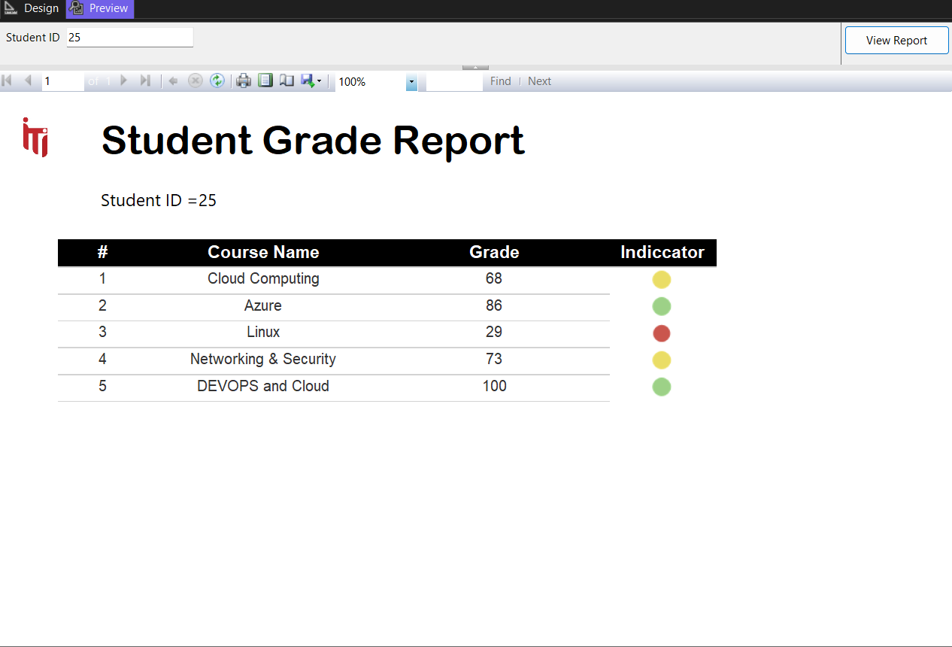
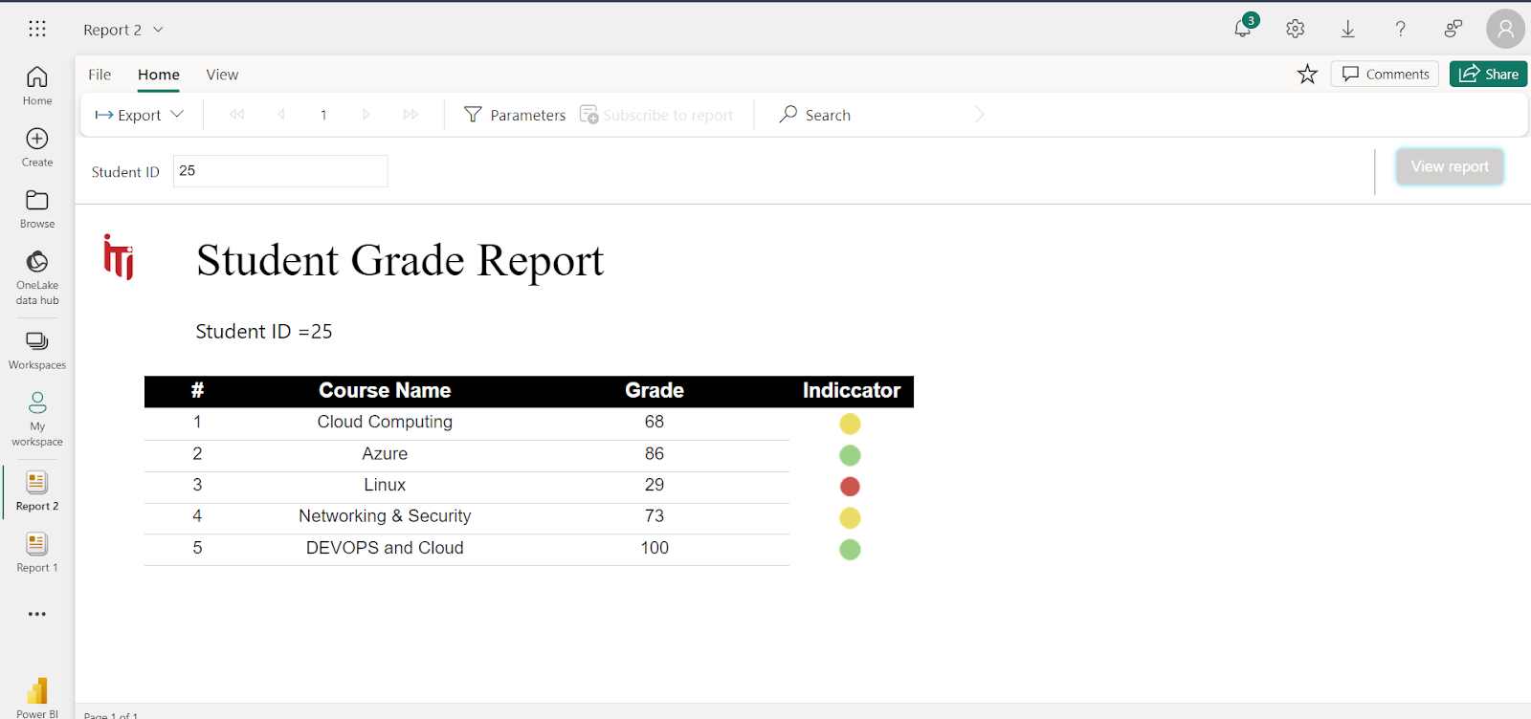
Technical Details – SSRS
Report that takes the student ID and returns the grades of the student in all courses

Slide 29
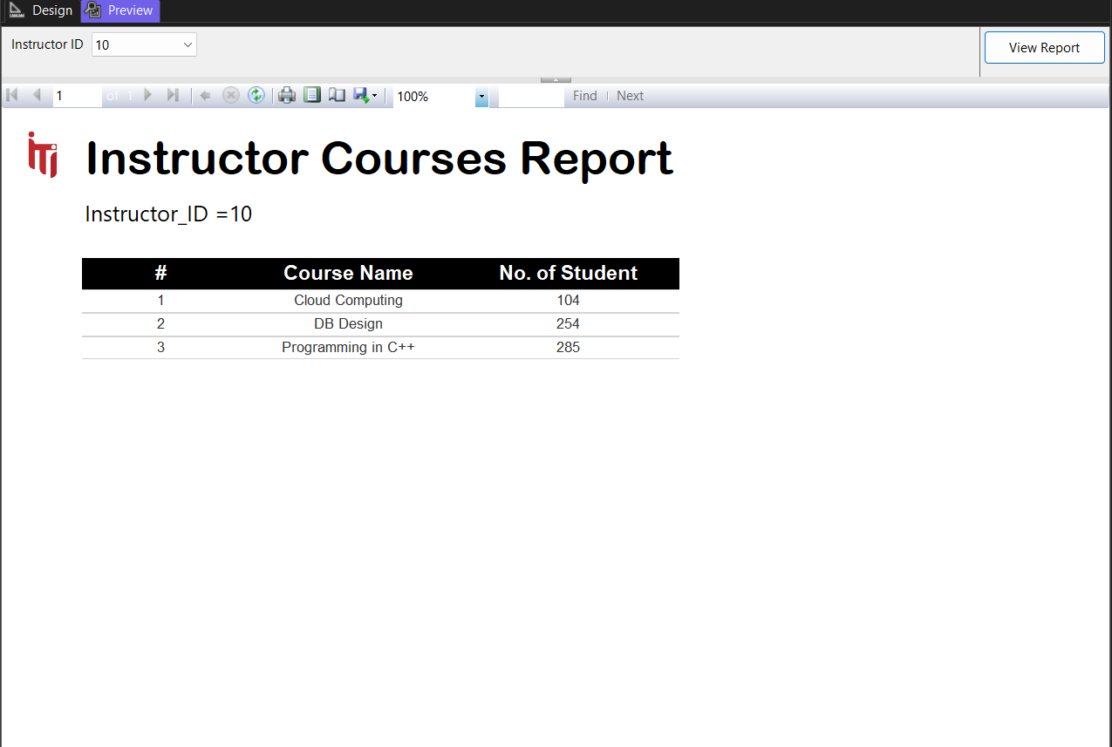
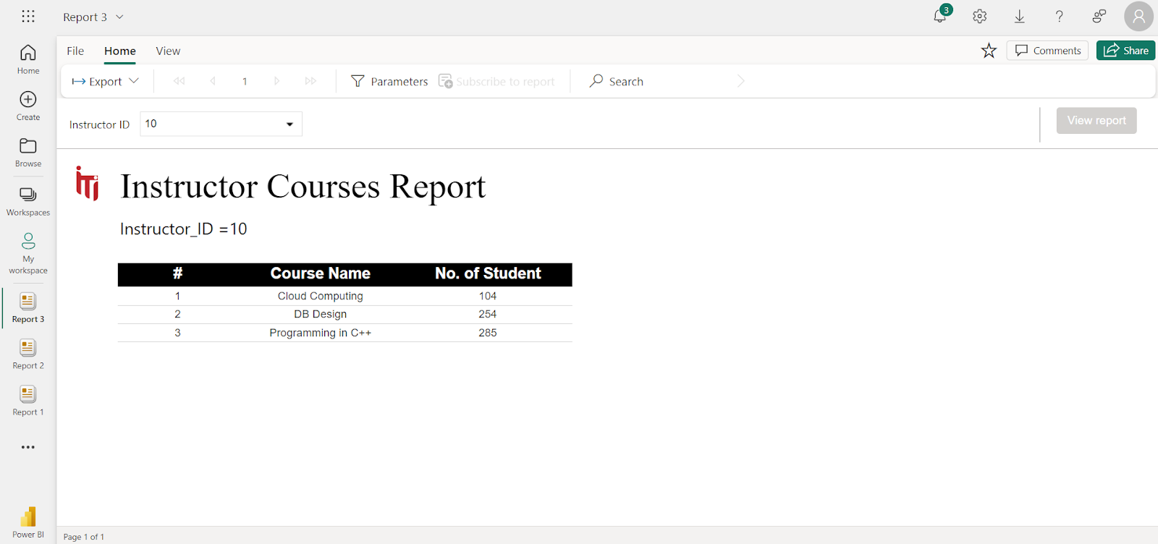
Technical Details – SSRS
takes the instructor ID and returns the name of the courses that he teaches and the number of students per course.

Slide 30
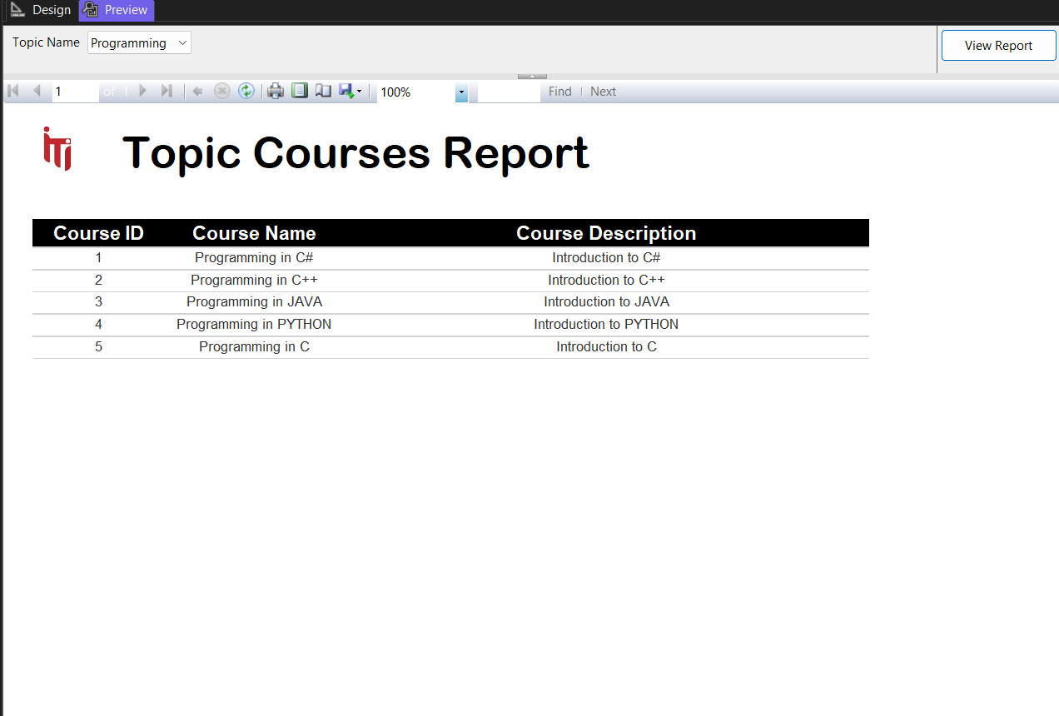
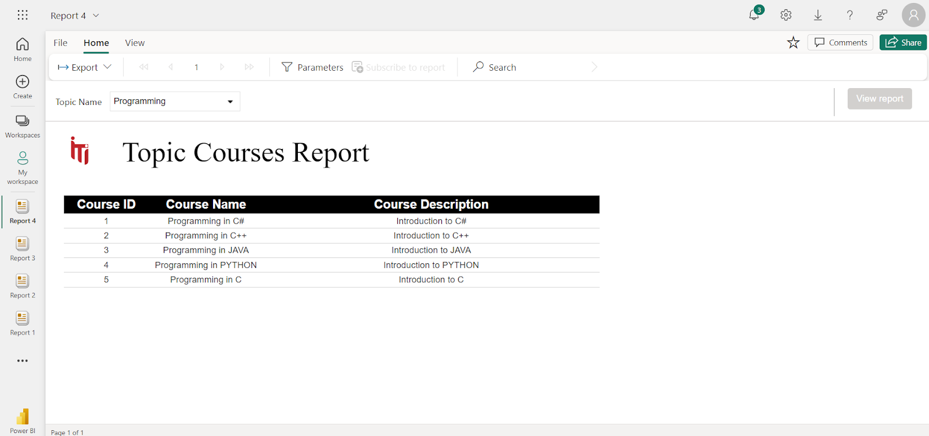
Technical Details – SSRS
Report that takes Topic ID and returns its Courses

Slide 31
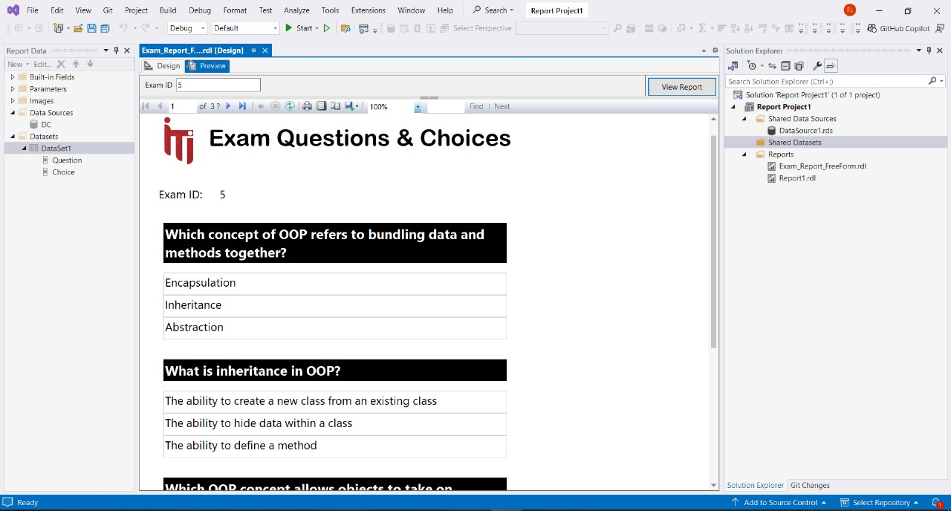
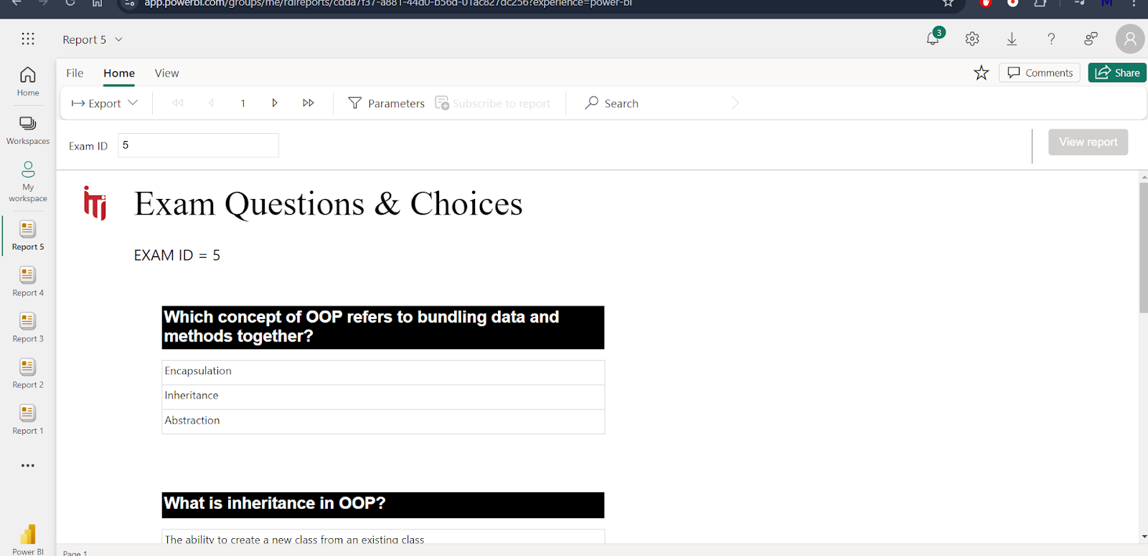
Technical Details – SSRS
Report that takes exam number and returns the Questions in it and choices [freeform report]

Slide 32
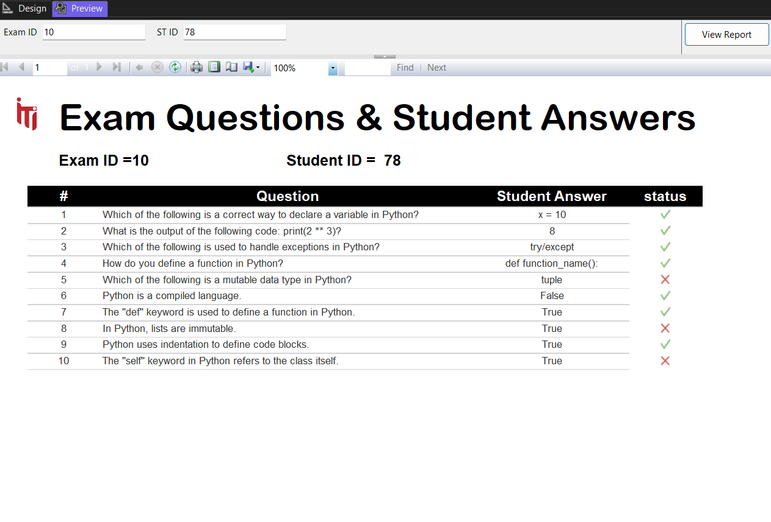
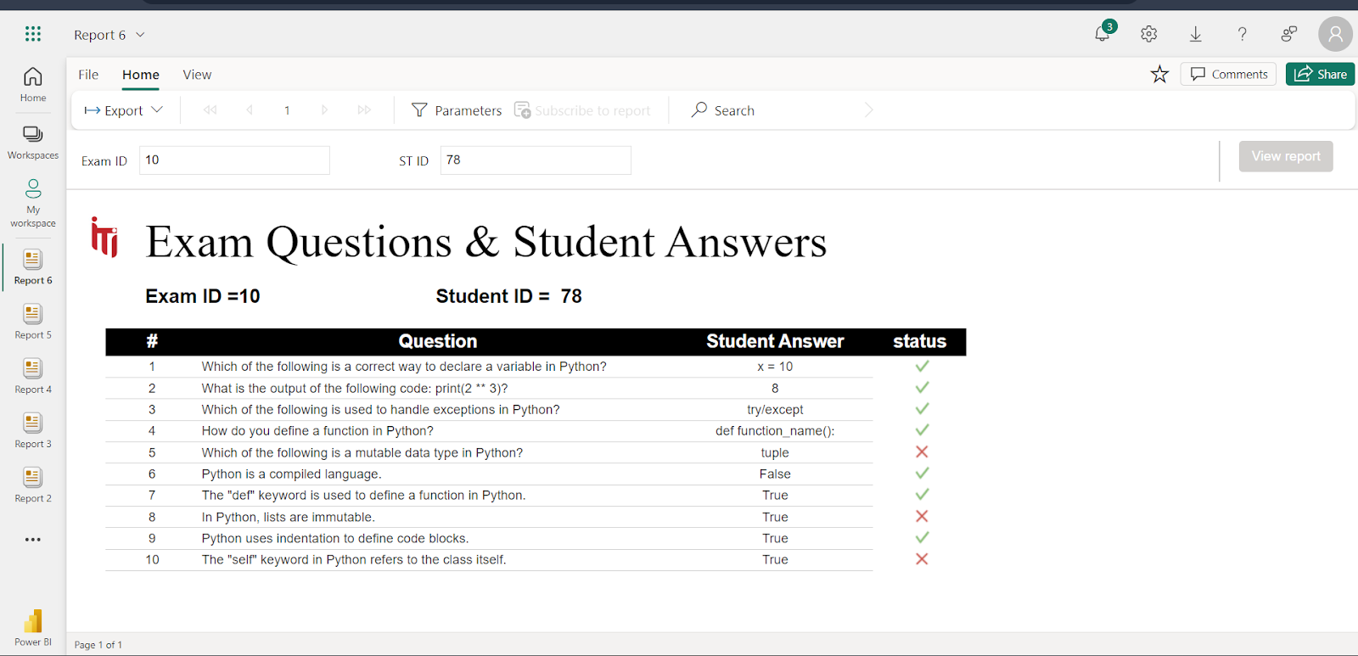
Technical Details – SSRS
Report that takes exam number and the student ID then returns the Questions in this exam with the student answers.

Slide 33

Technical Details – Power BI (Data Model)

Slide 34















Technical Details – Power BI Dashboard

Slide 35

Technical Details – Power BI Dashboard

Slide 36
Technical Details – Power BI Dashboard

Slide 37
Technical Details – Power BI Dashboard

Slide 38
Technical Details – Power BI Dashboard

Slide 39
Technical Details – Power BI Dashboard

Slide 40
Technical Details – Power BI Dashboard

Slide 41
Technical Details – Power BI Dashboard

Slide 42




Technical Details – Desktop App
Enable user to either register new student or start new exam

Slide 43






Technical Details – Desktop App
To make the process of examination easy and to use the procedures we build a desktop to show how the process is done

Slide 44
Non Technical Details – Obstacles
Meet the project deadline
Check the integrity in the data generation
Build desktop application and handle all the possible logic of it
The difference of the used tools versions
Collect all the work on one machine

Slide 45
Non Technical Details – Obstacles (Solutions)
Meet the project deadline – Organize Daily meetings to follow up
Check the integrity in the data generation – revisit and check the data with each procedure , report , dashboard
Build desktop application and handle all the possible logic of it – Build desktop on phases and test each form separately
The difference of the used tools versions – update the old version tools for all team members
Collect all the work on one machine – sync the database and send backup with each milestone

Slide 46








Used Tools
Used For Design ERD
- Build Desktop app - Create SSIS packages
- Create SSRS Reports
Used For host database , execute queries
- Build and design Dashboards
- Help in Generating data - Quickly Fixing bugs
- Team Meetings
- Prepare GP Document
- Team Connection

Slide 47

The End

Slide 48
Any Questions ?

